Slide 1
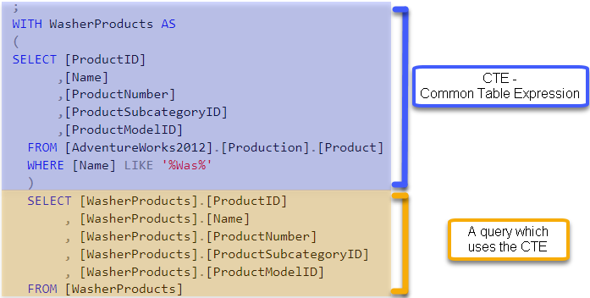

Slide 2


Slide 3
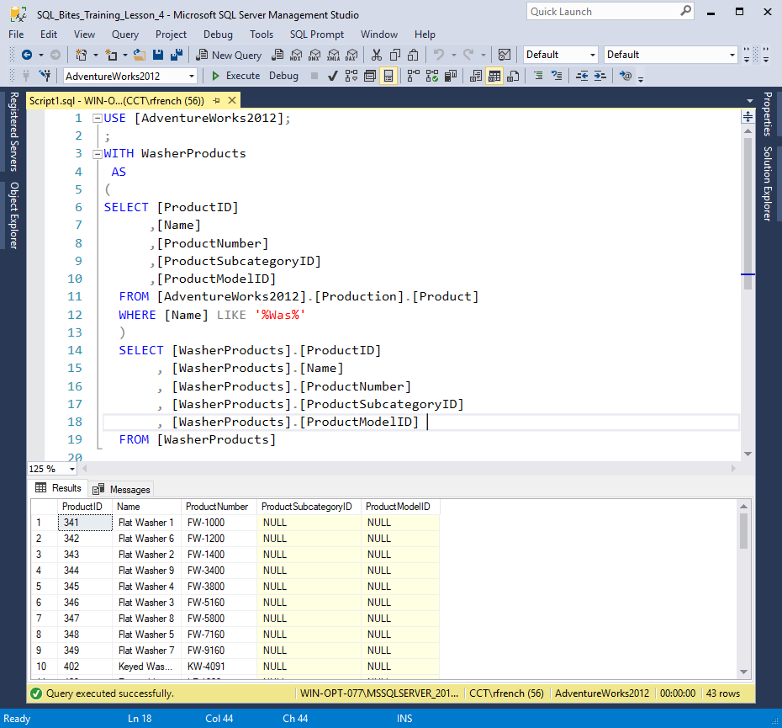
CTE version one (Figure 1)

Slide 4
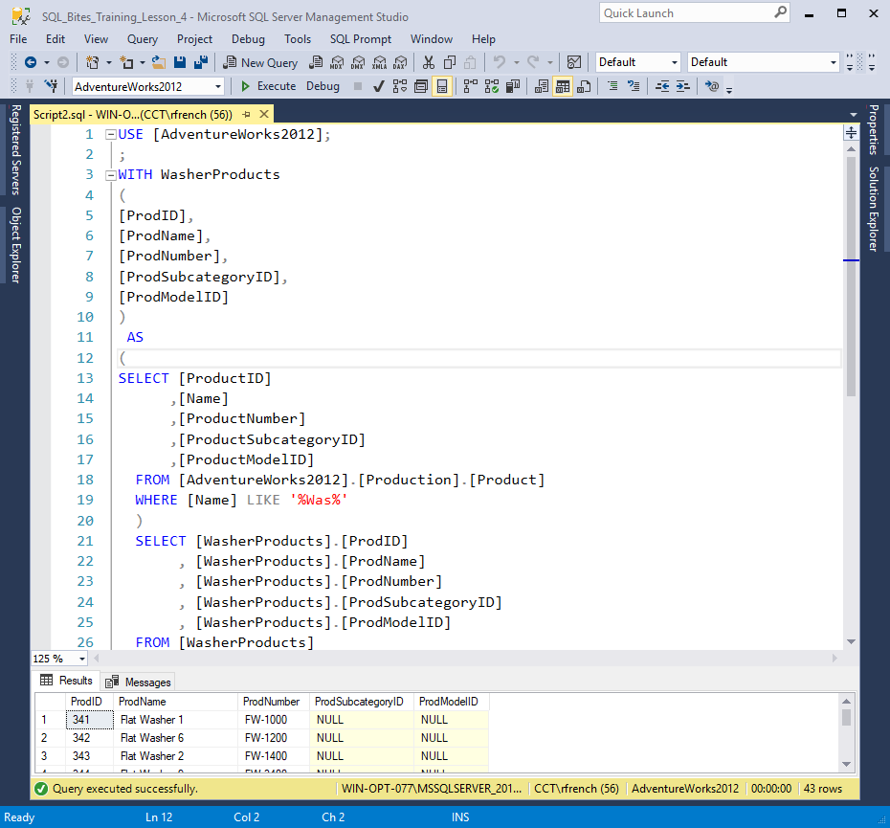
CTE version two (Figure 2)

Slide 5

Notes:
https://pixabay.com/en/important-stamp-imprint-2508600/

Slide 6


Notes:
Photo by Photos by Lanty on Unsplash

Slide 7
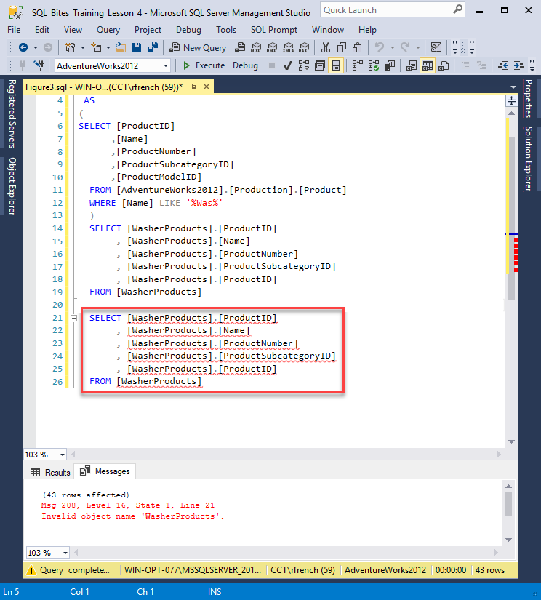
(Figure 3)

Slide 8
CTE’s what are they good for
(what can you do with them?)

Slide 9
Readability
Complexity

Slide 10
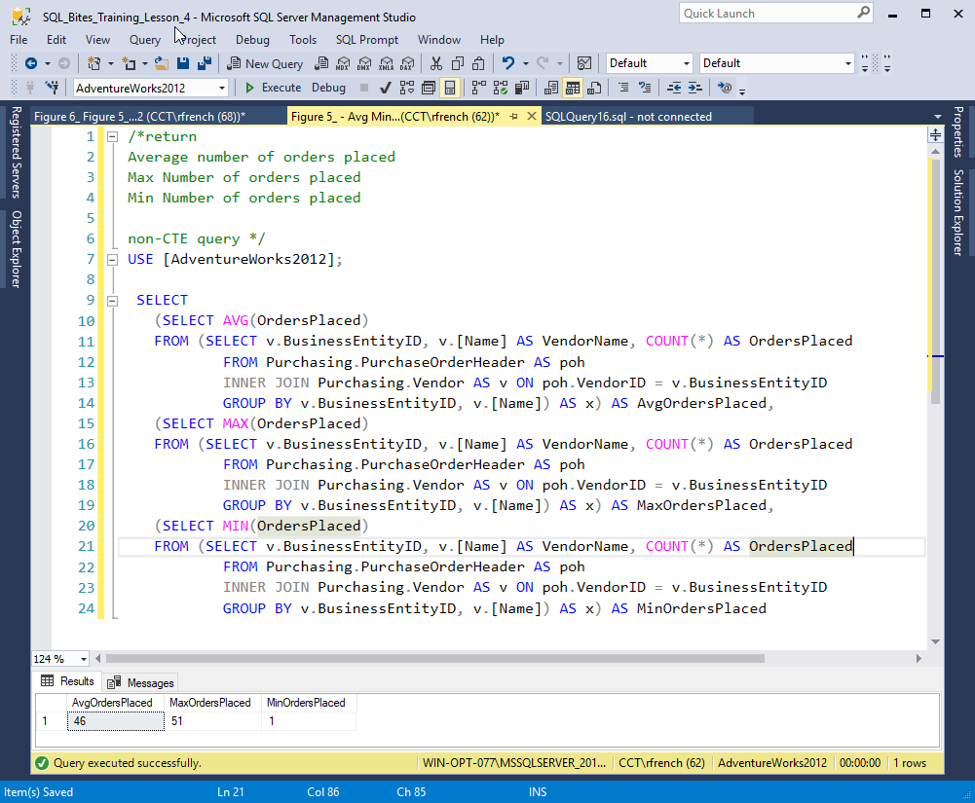
(Figure 4)
Notes:
https://facility9.com/2008/12/a-quick-introduction-to-common-table-expressions-3/

Slide 11
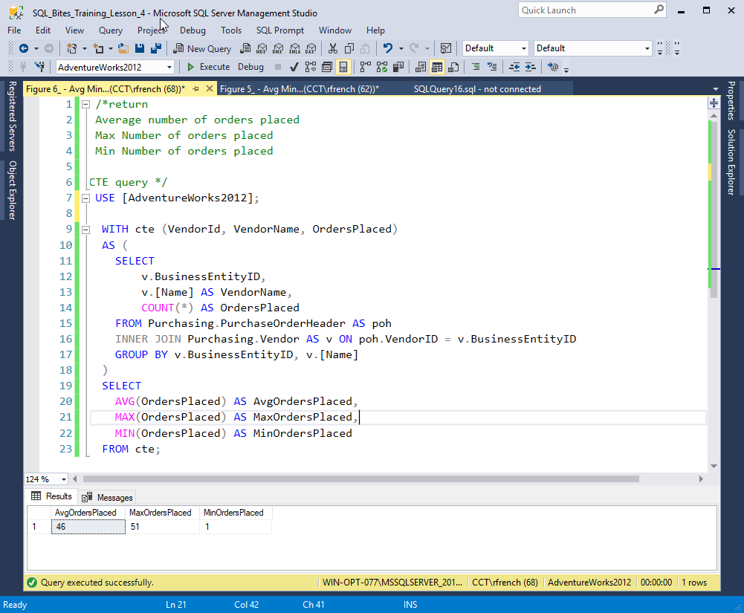
(Figure 5)
Notes:
https://facility9.com/2008/12/a-quick-introduction-to-common-table-expressions-3/

Slide 12
Question
What would need to change to filter by V.[PreferredVendorStatus]
Where = 1 or = 0

Slide 13
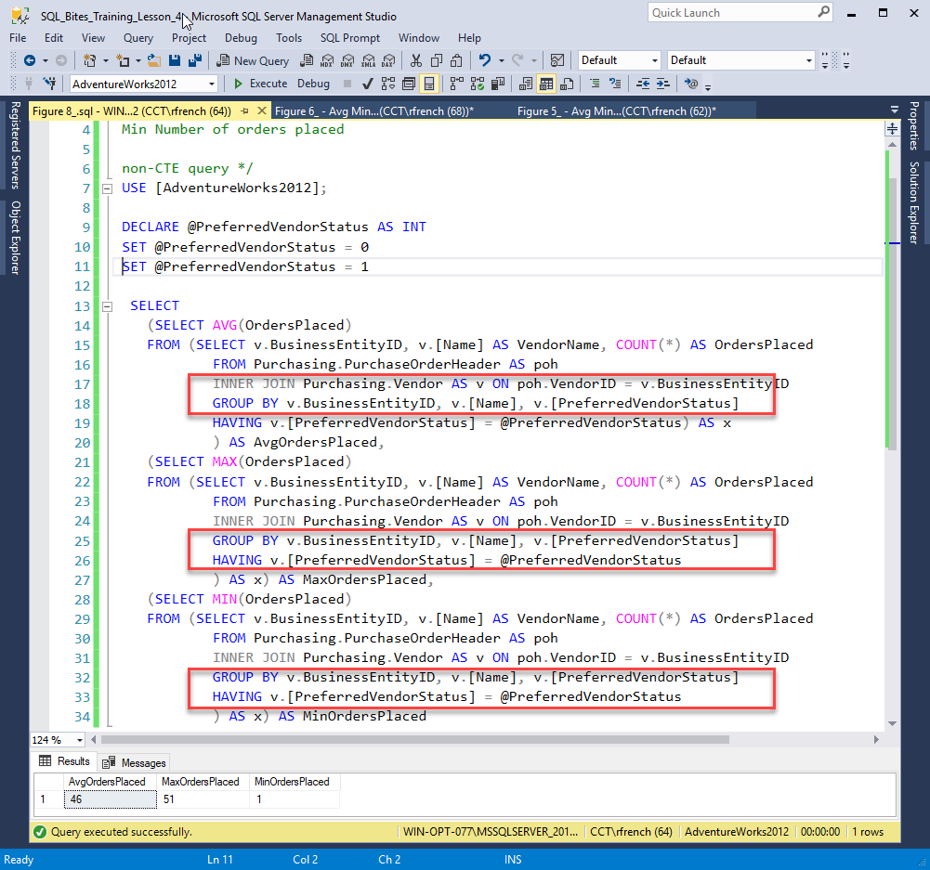
(Figure 6)

Slide 14
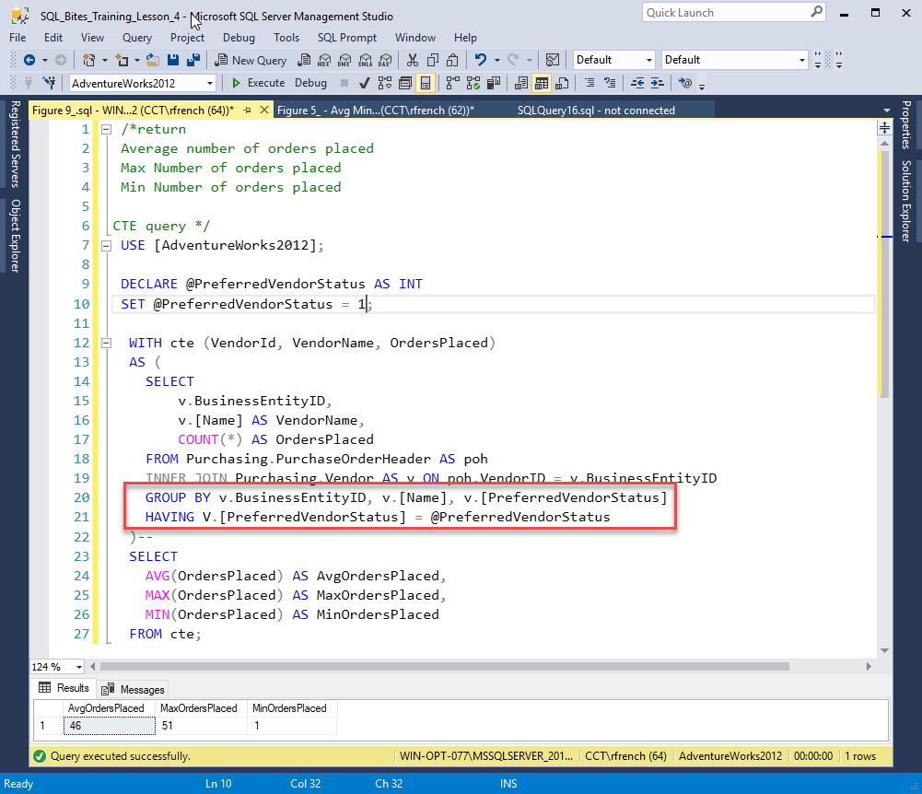
(Figure 7)

Slide 15


Slide 16


Slide 17


Slide 18
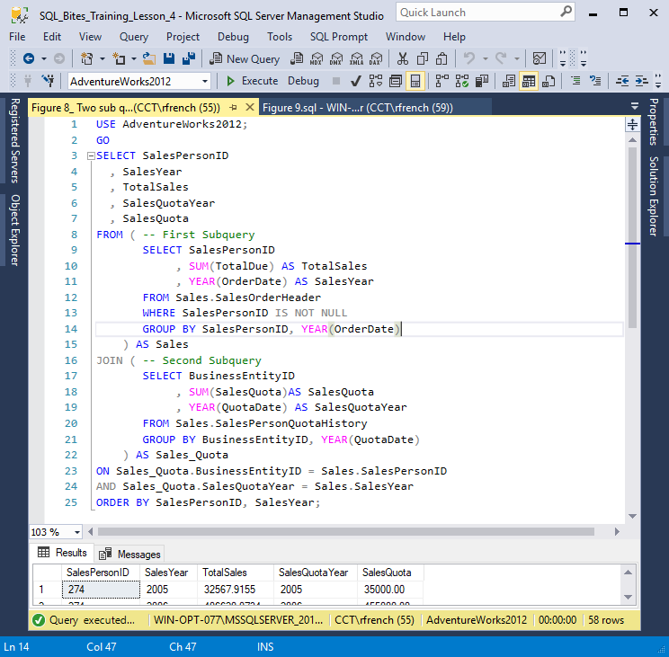
(Figure 8)

Slide 19
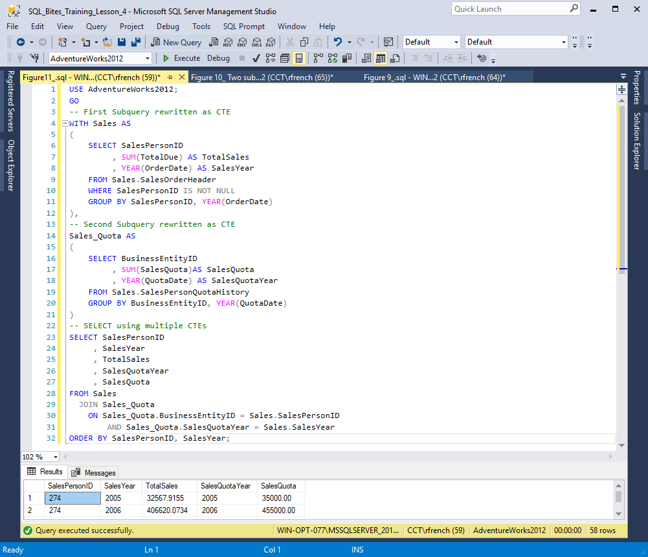
(Figure 9)
Notes:
http://www.sqlservercentral.com/articles/Stairway+Series/122606/

Slide 20


Slide 21
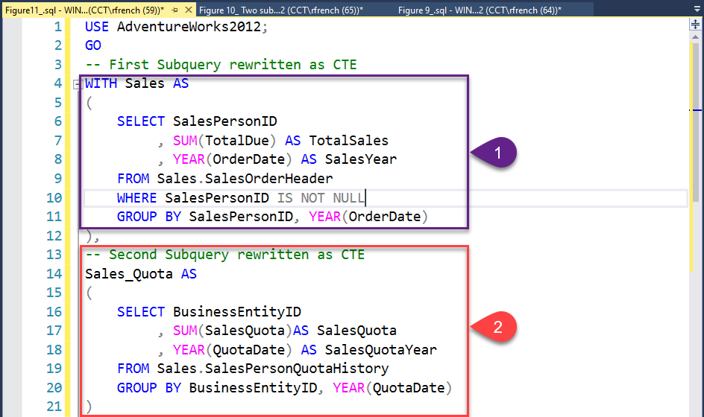

Slide 22
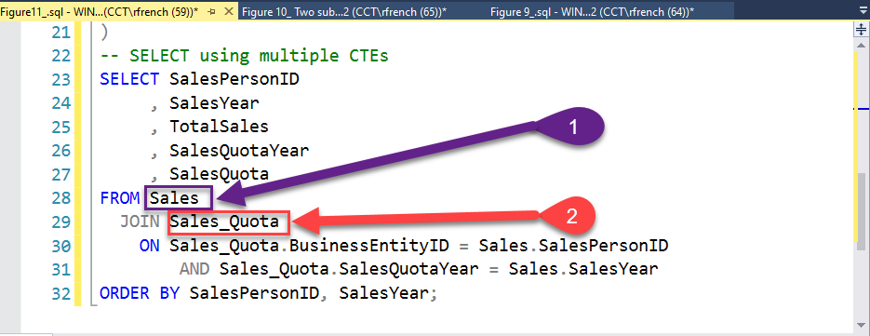

Slide 23
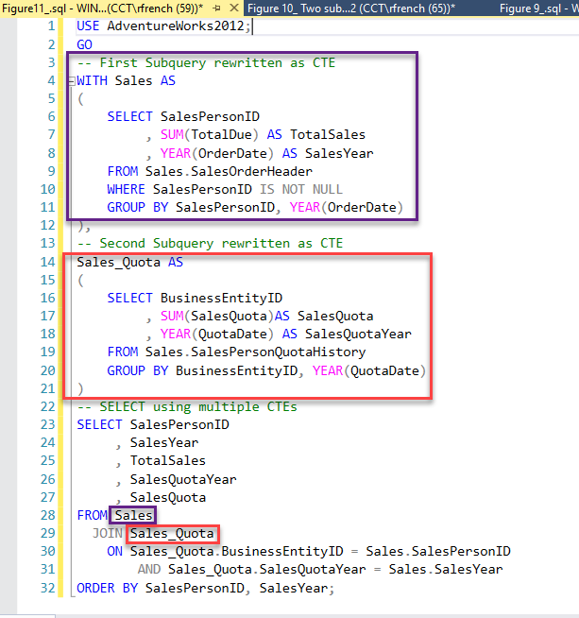

Slide 24


Slide 25
Update using CTE

Slide 26
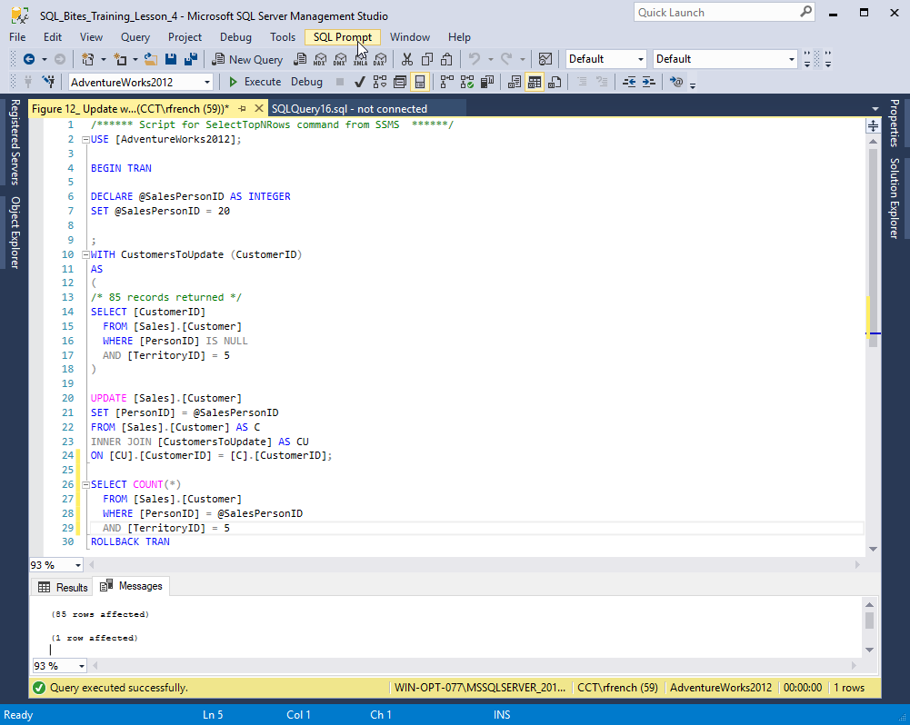
(Figure 10)

Slide 27
Delete using CTE

Slide 28
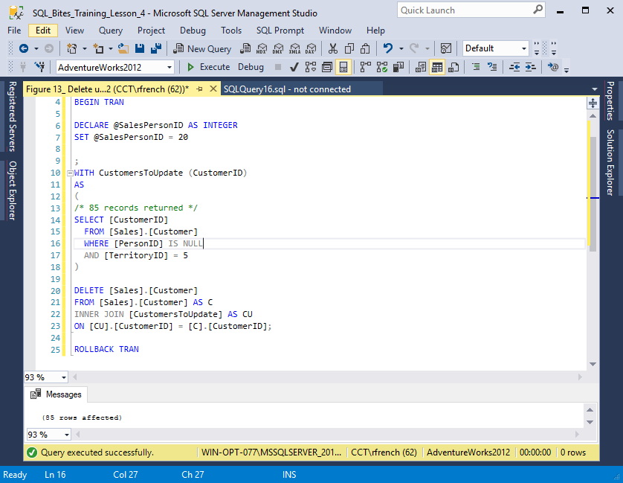
(Figure 11)

Slide 29
CTEs can also be used in
Views
Stored procedures
And many other objects

Slide 30
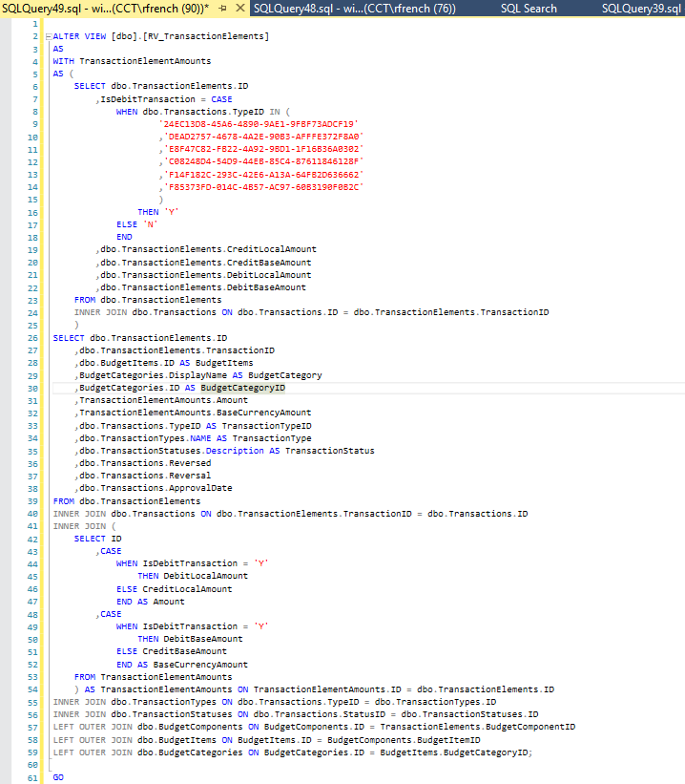
RV_TransactionElements

Slide 31

Recursion
A CTE can call itself

Slide 32
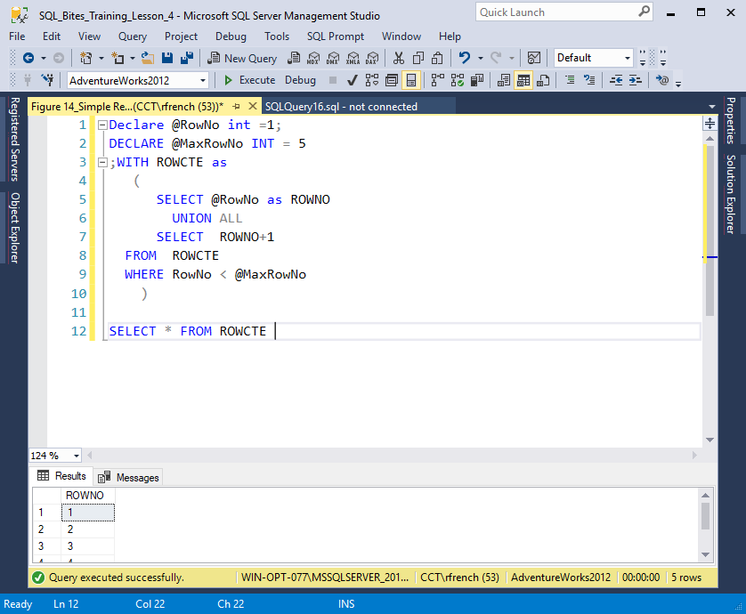

Slide 33


Slide 34
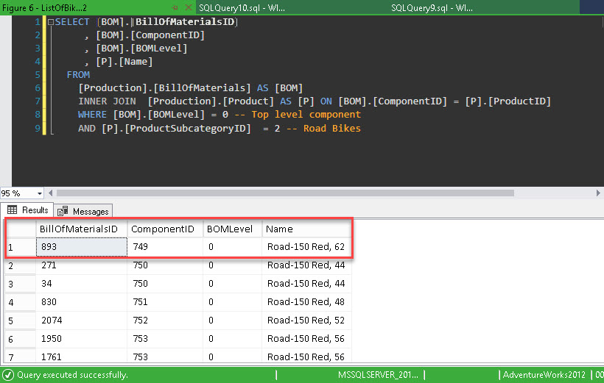
Top level component, a complete bike.
Which several components (e.g. Bottom bracket -> componentID 749)

Slide 35
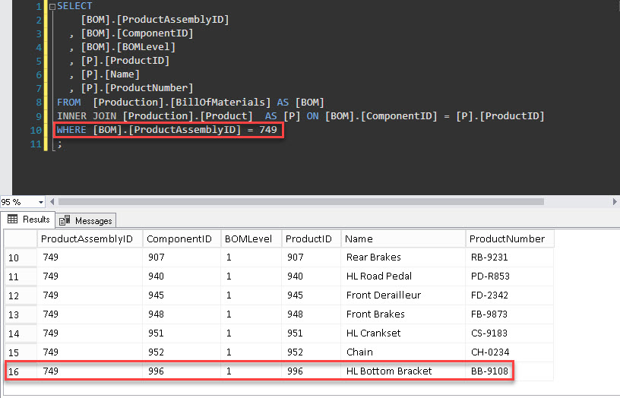
Bottom bracket -> componentID 749
NB BOM level = 1 e.g. 1st level down

Slide 36
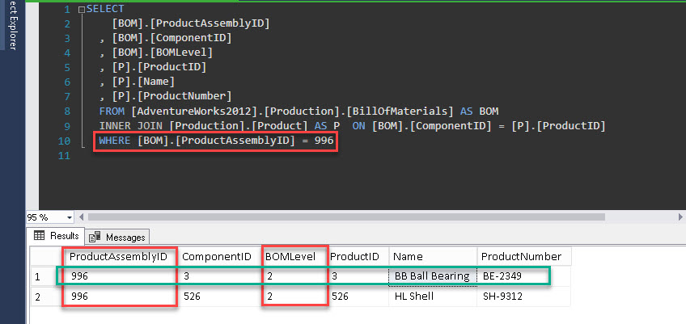
BB Ball Bearings-> componentID 996
NB BOM level = 2 e.g. 2nd level down

Slide 37
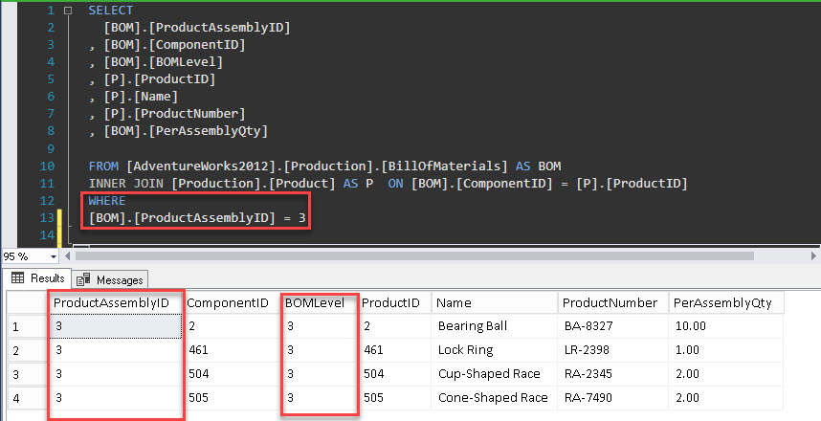
Query returns all the parts for
ProductAssemblyID = 3

Slide 38
Parent Record
SELECT 0 AS ParentComponent,
[BOM].[BillOfMaterialsID],
[BOM].[ProductAssemblyID],
[BOM].[ComponentID],
[BOM].[BOMLevel],
[BOM].[PerAssemblyQty],
[BOM].[EndDate],
[P].[ProductID],
[P].[Name],
/*set the product level at 1 to be the same as the [BOM].[BOMLevel]
ProductLevel Set to Zero*/
0 AS [ProductLevel],
CAST([P].[ProductID] AS VARCHAR(200)) AS AssemblyChain,
CAST(P.Name AS VARCHAR(100)) AS Sort
FROM [Production].[BillOfMaterials] AS [BOM]
INNER JOIN [Production].[Product] AS [P]
ON [BOM].[ComponentID] = [P].[ProductID]
WHERE ([BOM].[ComponentID] = 749)
AND
(
([BOM].[EndDate] IS NULL)
OR ([BOM].[EndDate] > GETDATE())
)
The query above returns this single record first time it runs.
This dataset is called [CTE_ComponentList]

Slide 39
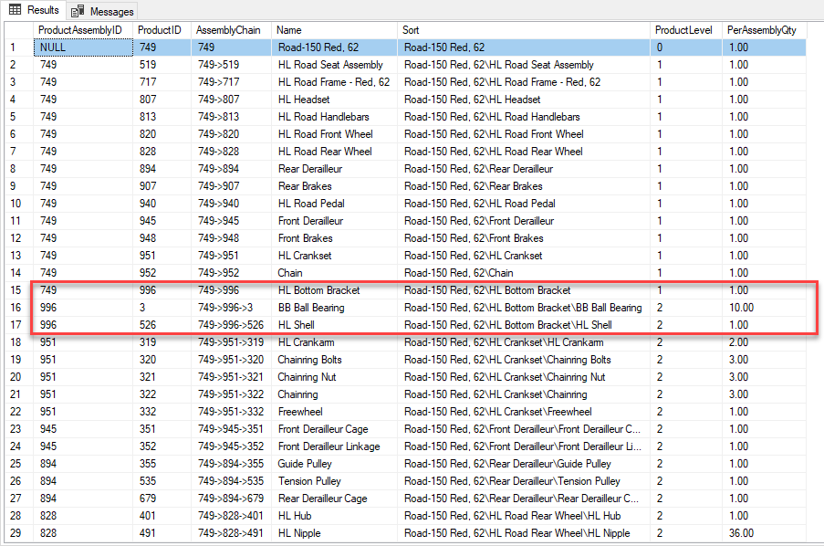
Bill of materials (BOM) for ProductID = 749

Slide 40
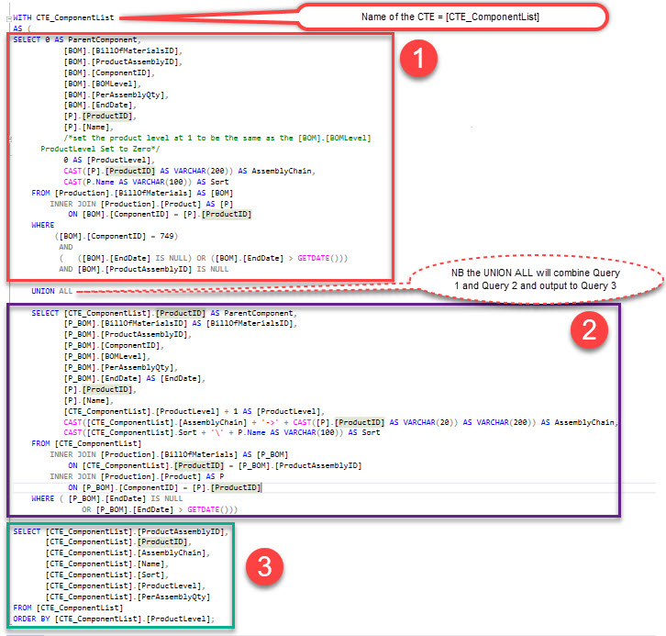

Slide 41
Next this query is run
SELECT [CTE_ComponentList].[ProductID] AS ParentComponent,
[P_BOM].[BillOfMaterialsID] AS [BillOfMaterialsID],
[P_BOM].[ProductAssemblyID],
[P_BOM].[ComponentID],
[P_BOM].[BOMLevel],
[P_BOM].[PerAssemblyQty],
[P_BOM].[EndDate] AS [EndDate],
[P].[ProductID],
[P].[Name],
[CTE_ComponentList].[ProductLevel] + 1 AS [ProductLevel],
CAST([CTE_ComponentList].[AssemblyChain] + '->' + CAST([P].[ProductID] AS VARCHAR(20)) AS VARCHAR(200)) AS AssemblyChain,
CAST([CTE_ComponentList].Sort + '\' + P.Name AS VARCHAR(100)) AS Sort
FROM [CTE_ComponentList]
INNER JOIN [Production].[BillOfMaterials] AS [P_BOM]
ON [CTE_ComponentList].[ProductID] = [P_BOM].[ProductAssemblyID]
INNER JOIN [Production].[Product] AS P
ON [P_BOM].[ComponentID] = [P].[ProductID]
WHERE (
[P_BOM].[EndDate] IS NULL
OR [P_BOM].[EndDate] > GETDATE()
)
The first time the recursive cte is run, the query above will be run using the dataset [CTE_ComponentList], which is shown below.
[CTE_ComponentList]

Slide 42
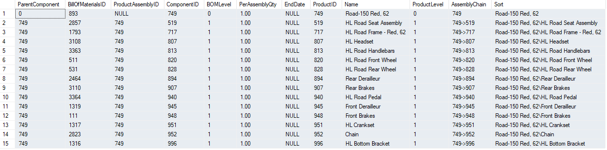
The output from the query is the following result set which is called Query 2
Query 2
[CTE_ComponentList]
The final step is use UNION ALL to combine the results set Query2 and [CTE_ComponentList]. On the next slide we will show the combined output resultset

